Slide 1
MATH 285 Midterm Review

Slide 2
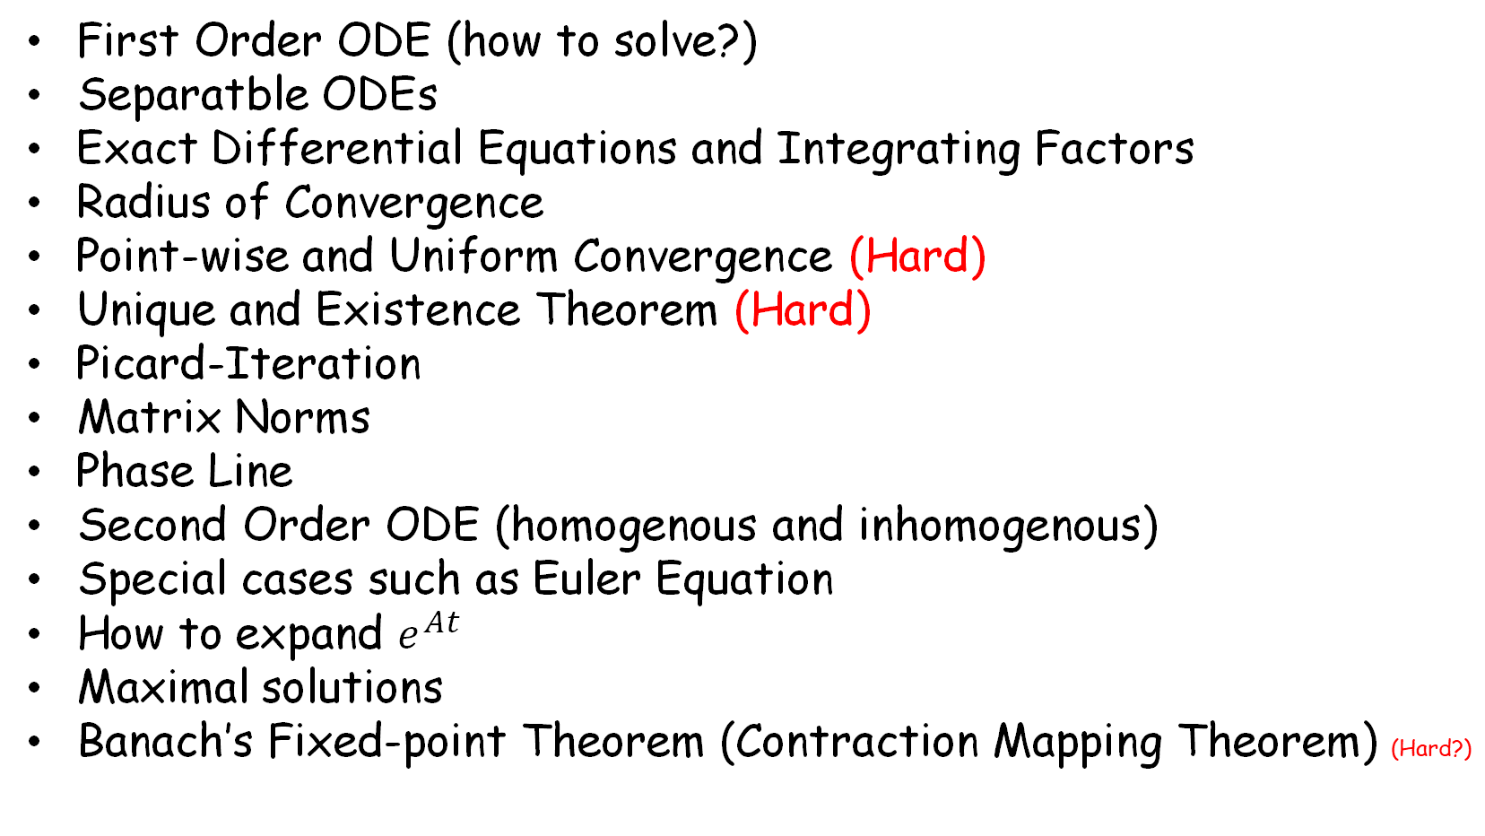
Things you should know
First Order ODE (how to solve?)
Separatble ODEs
Exact Differential Equations and Integrating Factors
Radius of Convergence
Point-wise and Uniform Convergence (Hard)
Unique and Existence Theorem (Hard)
Picard-Iteration
Matrix Norms
Phase Line
Second Order ODE (homogenous and inhomogenous)
Special cases such as Euler Equation
How to expand $e^{At}$
Maximal solutions
Banach’s Fixed-point Theorem (Contraction Mapping Theorem) (Hard?)

Slide 3
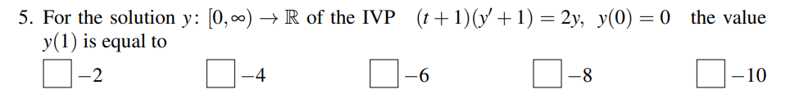
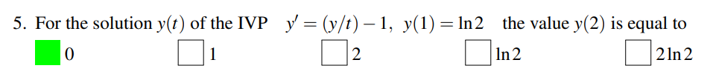
First Order ODE (how to solve?)

Slide 4
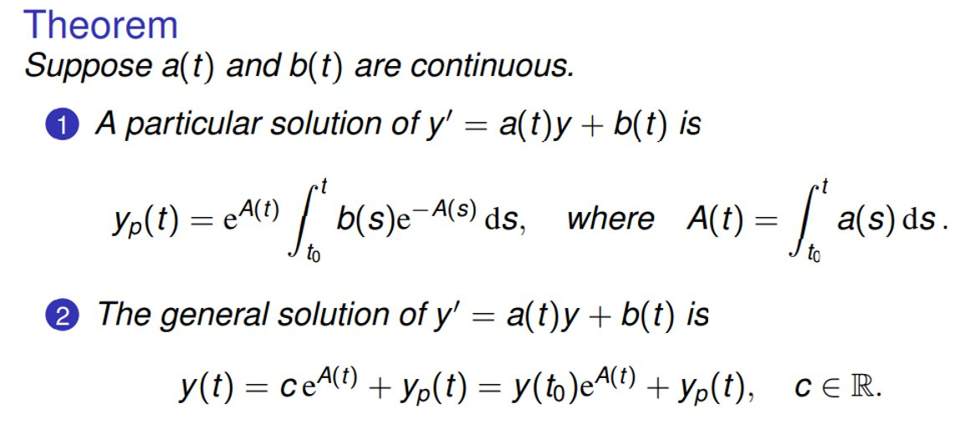

Slide 5
Separatble ODEs

Slide 6

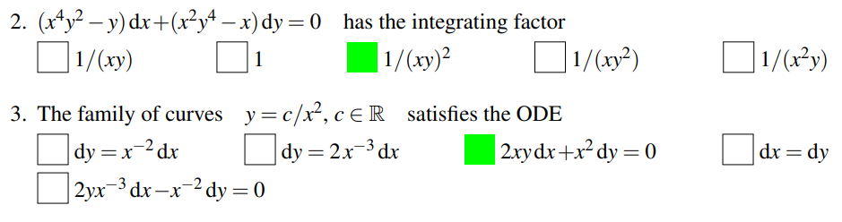
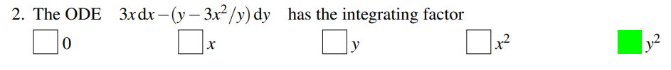
Exact Differential Equations and Integrating Factors

Slide 7
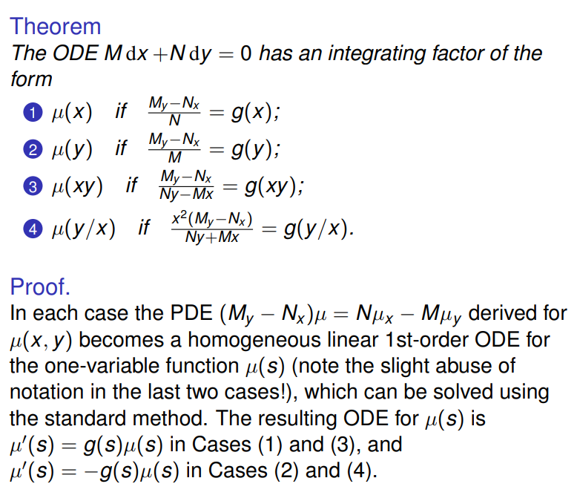


Slide 8

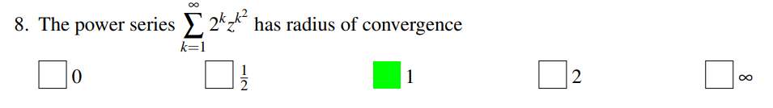
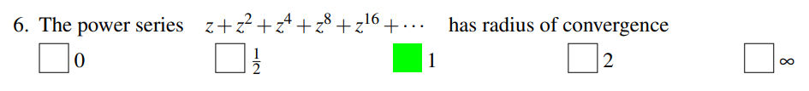
Radius of Convergence

Slide 9
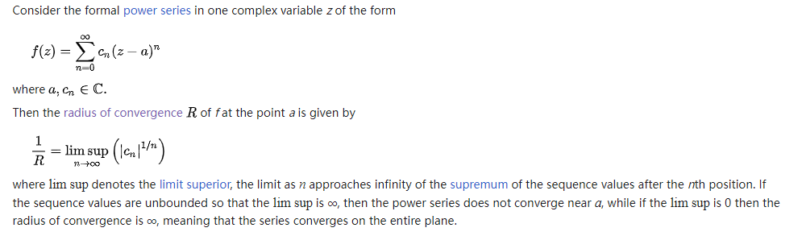
Cauchy-Hadamard formula

Slide 10
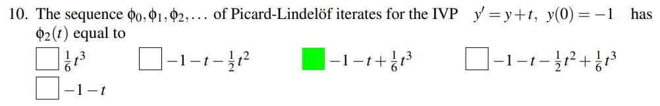
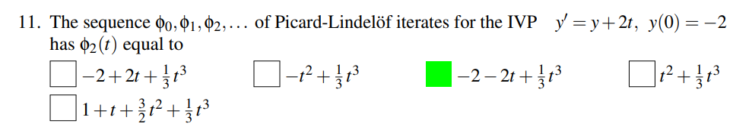
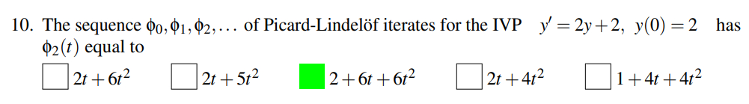
Picard-Iteration

Slide 11
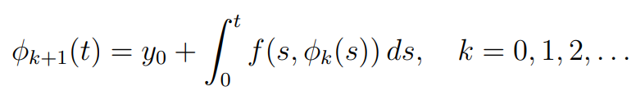
Picard-Lindelöf iteration (The method of successive approximations)

Slide 12
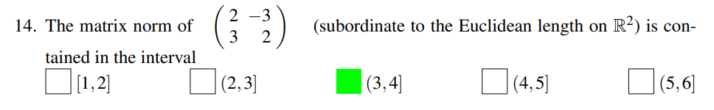
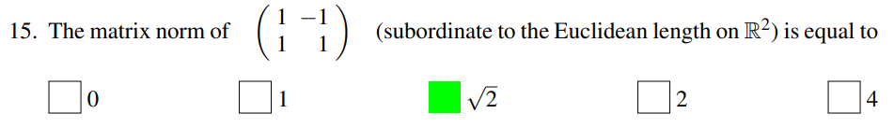
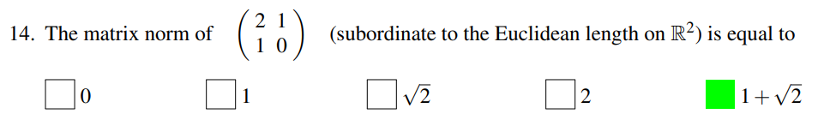
Matrix Norms

Slide 13
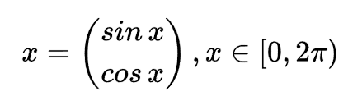


Matrix Norms and Frobenius norms
For a matrice A, the norm of A is
Let
is more simple. (Root of the sum of the squares)

Slide 14
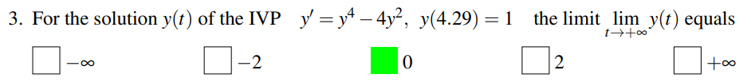
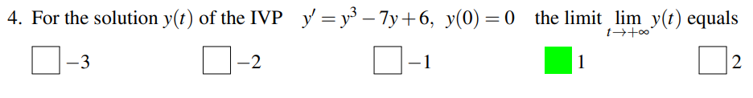
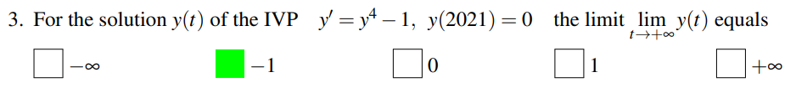
Phase Line

Slide 15
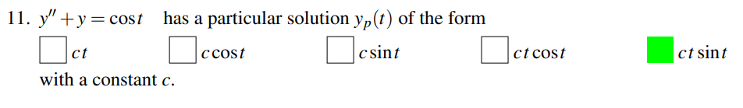
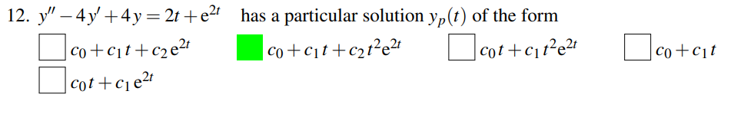
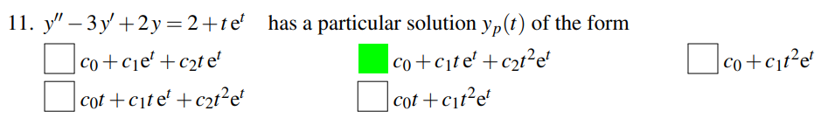
Second Order ODE (homogenous and inhomogenous)
Careful with C!

Slide 16
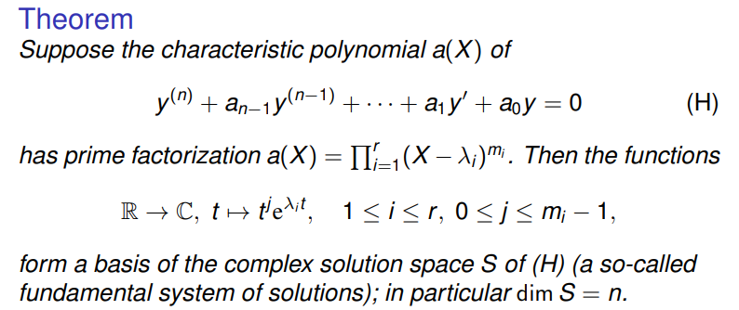
Second-order (or Higher) Ordinary Differential Equation

Slide 17
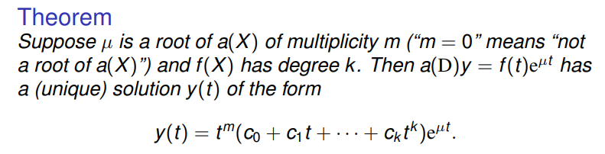
Inhomogeneous Case

Slide 18
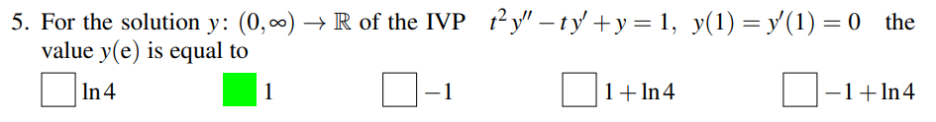
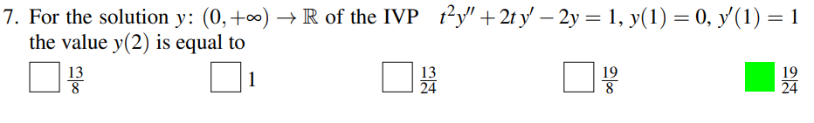
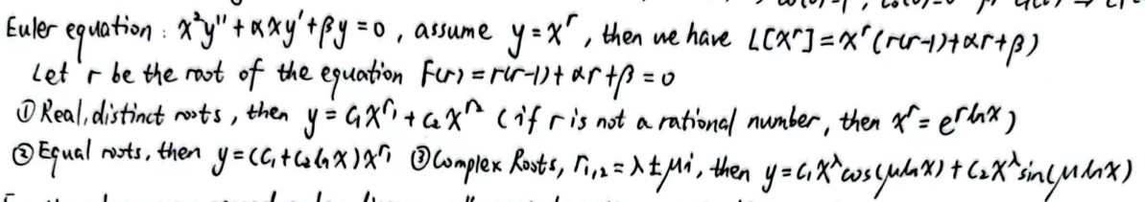
Special cases such as Euler Equation

Slide 19
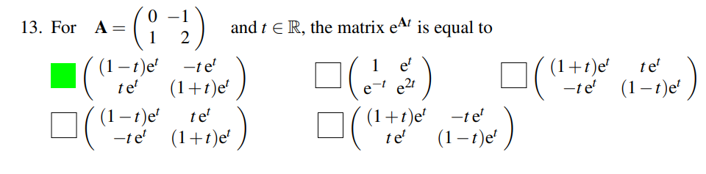
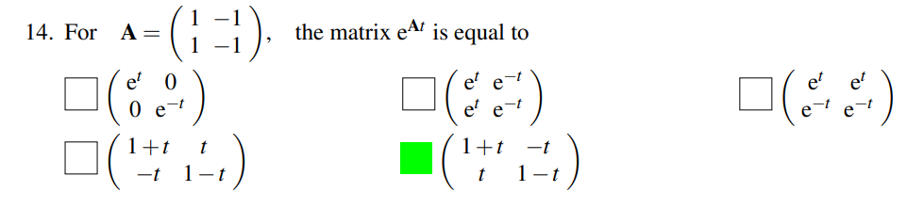
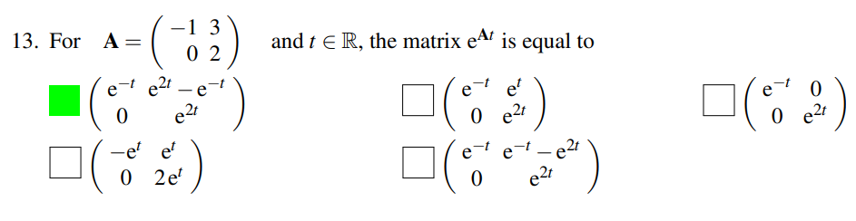
How to expand $e^{At}$

Slide 20
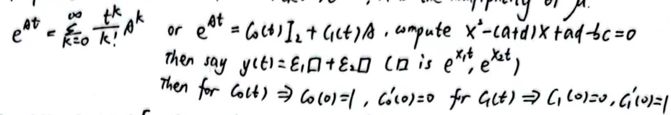
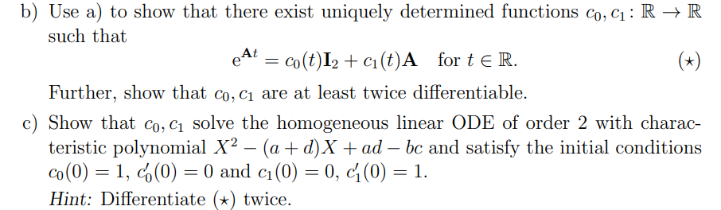
See homework 8 (homework 7 for MATH 286 ) for proof

Slide 21
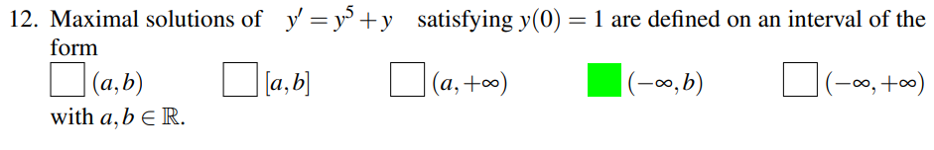
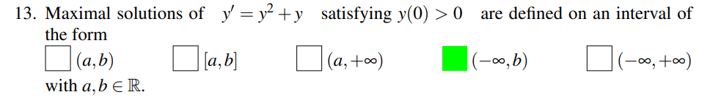
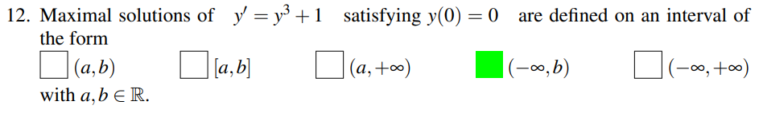
Maximal solutions

Slide 22
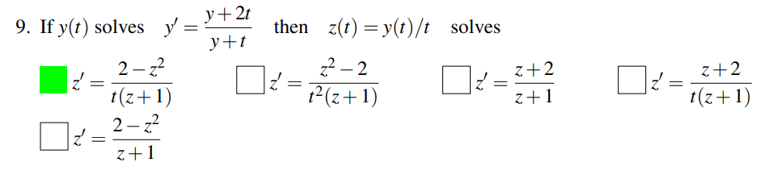
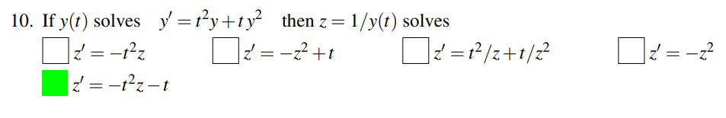
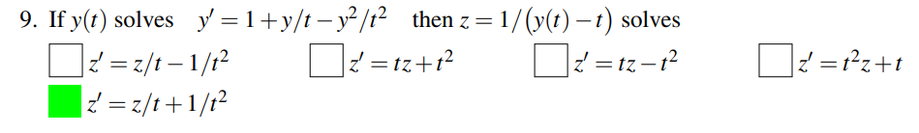
Some trivial but not hard staff (maybe?)

Slide 23
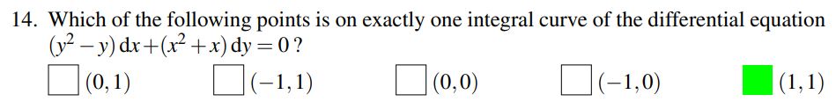
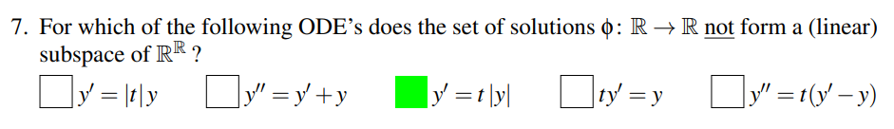
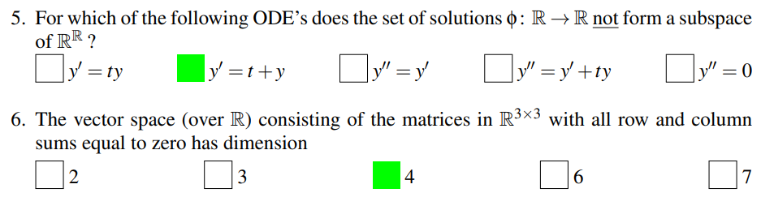
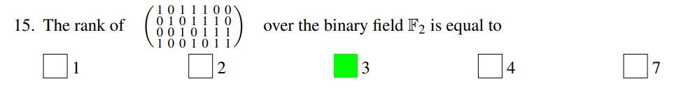

Slide 24
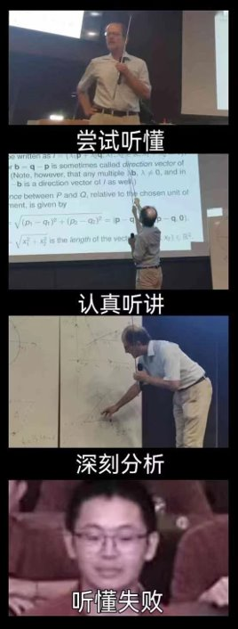
Now let’s dive into some harder stuff

Slide 25
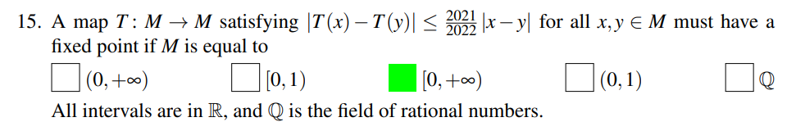

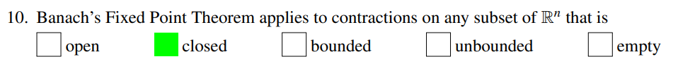
Banach’s Fixed-point Theorem (Contraction Mapping Theorem) (Hard?)

Slide 26
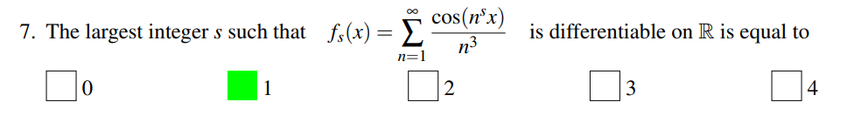

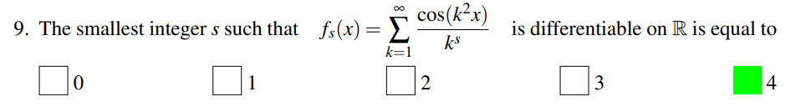
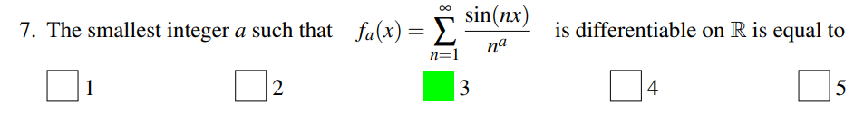
Point-wise and Uniform Convergence (Hard)
(Easy part)

Slide 27
Recall that...

Slide 28



Uniform Convergence and Point-wise Convergence
Uniform Convergence Point-wise Convergence
https://www.bilibili.com/video/BV1hh41127Js

Slide 29




(Well)

Slide 30
For the most challenging part of the midterm:

Slide 31


Lipschitz Condition

Slide 32


The Uniqueness and Existence Theorem

Slide 33



Unique and Existence Theorem (Hard, I suggest skip this first)

Slide 34



Slide 35

And this:
Good Luck!

